Slide 1
STM32 Mirror motor control
Student Lab 3b
14.11.2024

Slide 2
We have two motor: motor x, motor y

Slide 3
Lab3 content
Lab3a: Setting up hardware
- Connection of Motor driver board, NUCLEO board, and Mirror’s motors
Lab3b:
- Read motor position
- Control motor position

Slide 4
!! Before entering Lab 3b !!
The students must done Lab3a
All connection must be checked first by the Instructor

Slide 5
Lab3b
Read and control motor position
(ADC, UART, and PWM implementation)
Notes:
F:\AEE\AEE2\BSW\BSW Goals\ST firmware\StudentLab2024\Lab1a\Lab1a_LED_Button

Slide 6
Lab3b: Read and control motor position
In this lab, we will read Mirror’s motors (2 motors) positions.
Mirror has two potentiometers that can be read by MCU as analog inputs (ADC)
After reading, we will display the values via UART
After reading, we will manipulate the values as PWM to drive the motors
Please refer to previous lab to drive the motors
We will use FreeRTOS based code
Please refer to previous labs to set up the STM32CubeMX and STM32CubeIDE project
Notes:
F:\AEE\AEE2\BSW\BSW Goals\ST firmware\StudentLab2024\Lab1b\Lab1b_LED_Button

Slide 7

Lab3b: Read and control motor position
There will be error flag reading from the Driver (LO1 and LO2)
If there is Open Load flag, the Driver will not stop.
If there is Over Current or Over Thermal flag, the Driver will stop.
The MCU uses 3.3 VDC as supply voltage (VDD).
Be careful to not exceed the voltage to digital input pins (LO1 and LO2).
There is voltage divider to be set to limit the input from 5 VDC to be less than 3.3 VDC
Notes:
F:\AEE\AEE2\BSW\BSW Goals\ST firmware\StudentLab2024\Lab1b\Lab1b_LED_Button

Slide 8
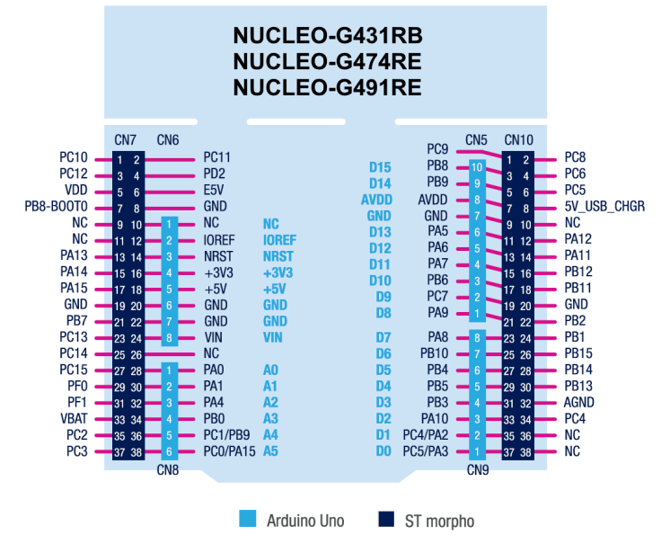
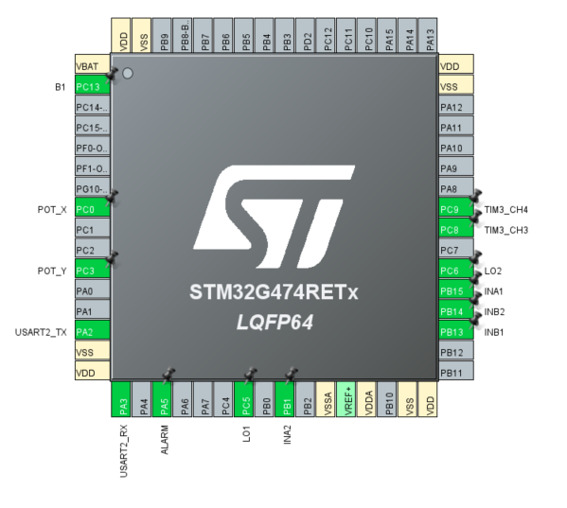
Lab3b: Read and control motor position
PINS settings and connections
PWMB
PWMA
LO2
LO1
INA2
INA1
INB2
INB1
POT_Y
POT_X
Notes:
F:\AEE\AEE2\BSW\BSW Goals\ST firmware\StudentLab2024\Lab1b\Lab1b_LED_Button

Slide 9
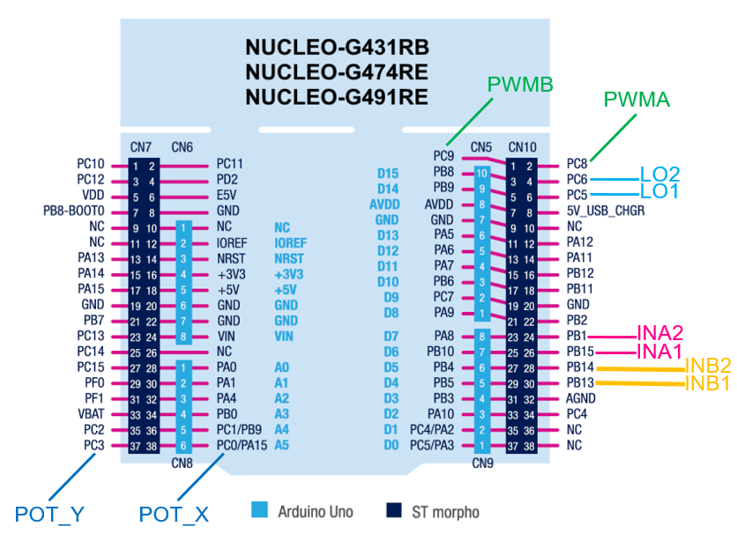
Lab3b: Read and control motor position
We will set analog input pins of MCU to read potentiometers of mirror.
Analog input is converted to digital using ADC
We use 12-bit ADC (ADC value is 0 - 4095)
We will set:
PC0 as analog inputs ADC2_IN6 (POT_X of Mirror)
PC3 as analog inputs ADC2_IN9 (POT_Y of Mirror)
We will read voltages from PC0 and PC3 (using ADC polling conversion)
The MCU uses 3.3 VDC as supply voltage (VDDA).
Be careful to not exceed the voltage to analog input pins (POT_X and POT_Y).
There are voltage dividers to be set to limit the input from 5 VDC to be less than 3.3 VDC
Notes:
F:\AEE\AEE2\BSW\BSW Goals\ST firmware\StudentLab2024\Lab1b\Lab1b_LED_Button

Slide 10
Lab3b: Read and control motor position
Lab3b: Read and control motor position
Voltage calculation of POT_X
Potentiometer of Motor X is 1K Ohm until 5 K Ohm resistance
Power supply of potentiometer is 5 VDC
ADC voltage max is 3.3 VDC (VDDA)
If the resistor for voltage divider is 1.5K Ohm
The voltages after voltage divider is:
Min = 1.154 VDC (for 5K resistance)
Max = 3 VDC (for 1K resistance)
Voltage calculation of POT_Y
Potentiometer of Motor Y is 3K Ohm until 5 K Ohm resistance
Power supply of potentiometer is 5 VDC
ADC voltage max is 3.3 VDC (VDDA)
If the resistor for voltage divider is 4.7K Ohm
The voltages after voltage divider is:
Min = 2.423 VDC (for 5K resistance)
Max = 3 .052 VDC (for 3K resistance)
Notes:
F:\AEE\AEE2\BSW\BSW Goals\ST firmware\StudentLab2024\Lab1b\Lab1b_LED_Button

Slide 11
Lab3b: Read and control motor position
For UART communication:
We will set:
PA2 as UART TX
PA3 as UART RX
We will use Console from STM32CubeIDE to monitor the serial print
Notes:
F:\AEE\AEE2\BSW\BSW Goals\ST firmware\StudentLab2024\Lab1b\Lab1b_LED_Button

Slide 12
Lab3b: Read and control motor position
For PWM outputs:
We will set:
PC8 as TIM3_CH3 (for PWMA of Motor driver)
PC9 as TIM3_CH4 (for PWMB of Motor driver)
Timer 3 channel 3 and Timer 3 channel 4 will be set as PWM generator.
F (PWM) = F (Clock) / ((Prescaler+1) (Period+1))
Example in the code: 170MHz / (169+1)(999+1) = 1000 Hz
Notes:
F:\AEE\AEE2\BSW\BSW Goals\ST firmware\StudentLab2024\Lab1b\Lab1b_LED_Button

Slide 13
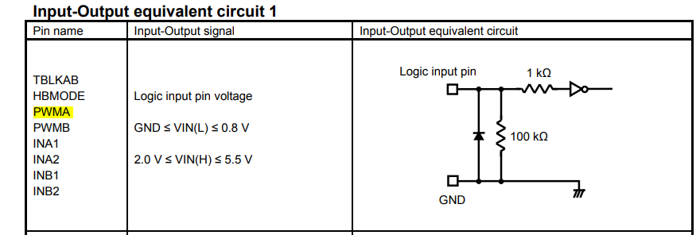
Lab3b: Read and control motor position
PWMA and PWMB as input of Motor driver have characteristic:
LOW is 0.8 VDC and below
HIGH is 2.0 VDC and above
PWM from NUCLEO gives maximum voltage 3.3 VDC (not 5 VDC)
This table below is the Motor driver characteristics:
Notes:
F:\AEE\AEE2\BSW\BSW Goals\ST firmware\StudentLab2024\Lab1b\Lab1b_LED_Button

Slide 14
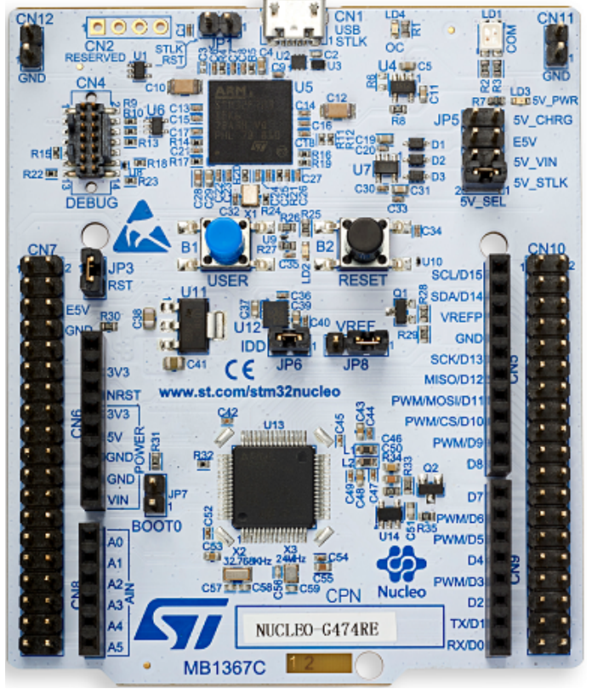
Lab3b: Read and control motor position
Additional setting:
B1 or Blue button (PC13) of NUCLEO to stop both motors or other purpose
LD2 (PA5) of NUCLEO as ALARM or other purpose
User Button B1
User LED LD2
Notes:
F:\AEE\AEE2\BSW\BSW Goals\ST firmware\StudentLab2024\Lab1b\Lab1b_LED_Button

Slide 15
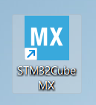
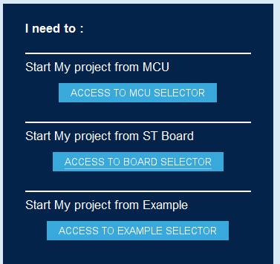
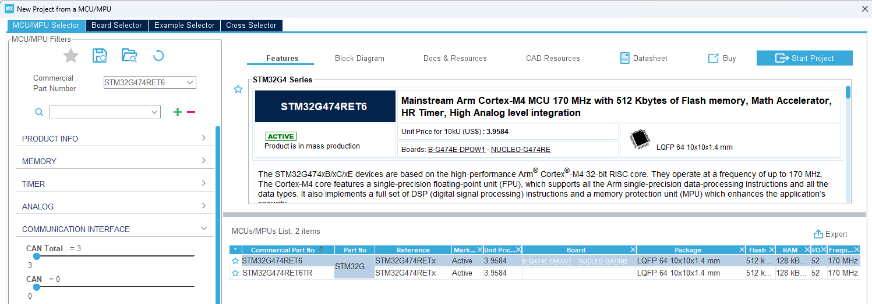
Lab3b: Read and control motor position
Open STM32MCubeMX
Click
Click
Notes:
F:\AEE\AEE2\BSW\BSW Goals\ST firmware\StudentLab2024\Lab1b\Lab1b_LED_Button

Slide 16
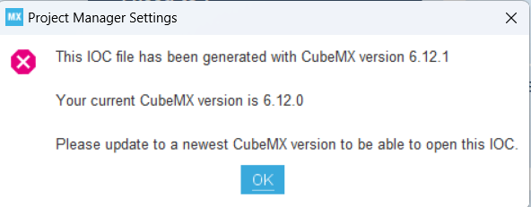
Lab3b: Read and control motor position
Caution!
The .ioc file in the project uses STM32CubeMX version 6.12.1.
If you have different type of version that older than this version, you will not be able to open it and you need to update it or to download the new installation from ST website
STM32CubeMX - STM32Cube initialization code generator - STMicroelectronics
Notes:
F:\AEE\AEE2\BSW\BSW Goals\ST firmware\StudentLab2024\Lab1b\Lab1b_LED_Button

Slide 17
Lab3b: Read and control motor position
Set the MCU pins in STM32CubeMX as described.
Four GPIO output pins
PB15 for INA1
PB1 for INA2
PB13 for INB1
PB14 for INB2
Two GPIO input pins for feedback LO1 and LO2
PC6 for LO1
PC5 for LO2
Caution! These two pins MUST be connected to pull-up connection.
Notes:
F:\AEE\AEE2\BSW\BSW Goals\ST firmware\StudentLab2024\Lab1a\Lab1a_LED_Button

Slide 18
Lab3b: Read and control motor position
Set the MCU pins in STM32CubeMX as described.
Two PWM output pins
PC8 as TIM3_CH3 for PWMA of Motor driver
PC9 as TIM3_CH4 for PWMB of Motor driver
Two Analog input pins for POT_X and POT_Y
PC0 (ADC2_IN6) for POT_X of Mirror
PC3 (ADC2_IN9) for POT_Y of Mirror
Two UART pins
PA2 (USART_TX)
PC3 (USART_RX)
Notes:
F:\AEE\AEE2\BSW\BSW Goals\ST firmware\StudentLab2024\Lab1a\Lab1a_LED_Button

Slide 19
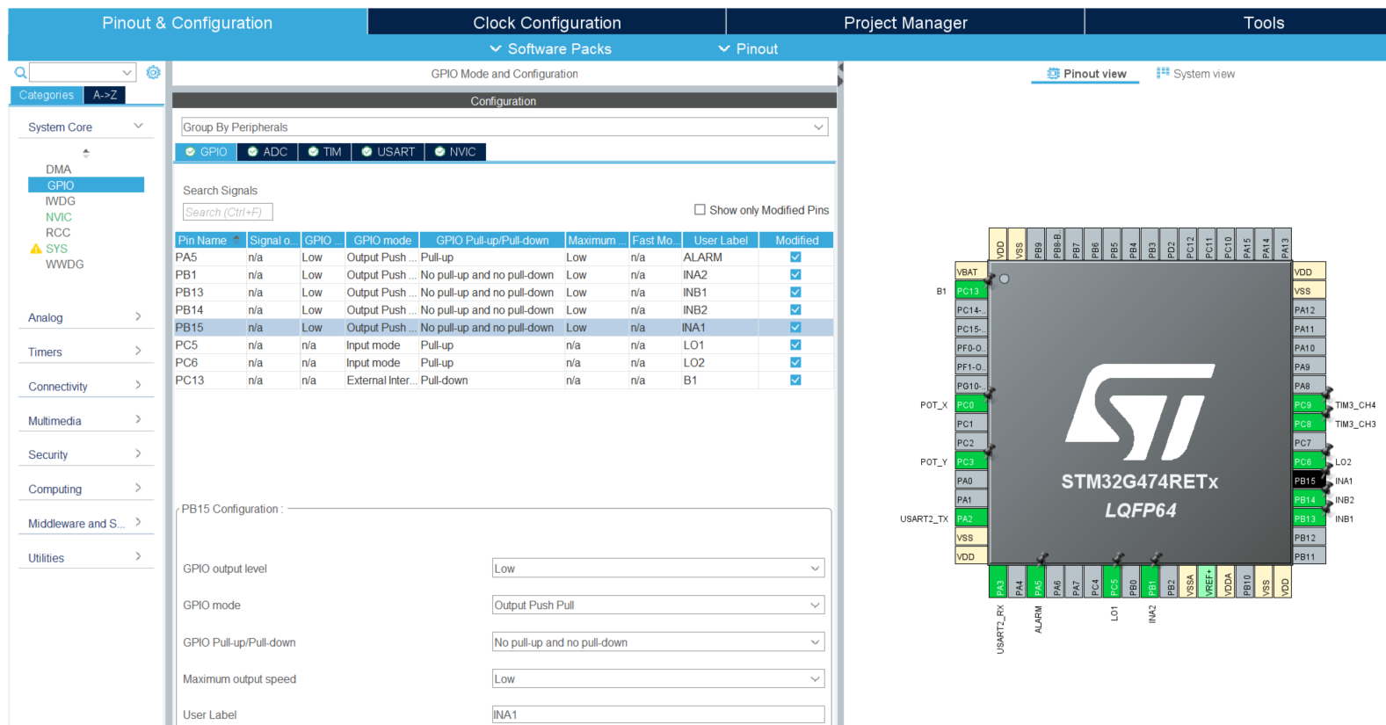
Lab3b: Read and control motor position
Set GPIO Mode and Configuration as below:
Notes:
F:\AEE\AEE2\BSW\BSW Goals\ST firmware\StudentLab2024\Lab1b\Lab1b_LED_Button

Slide 20
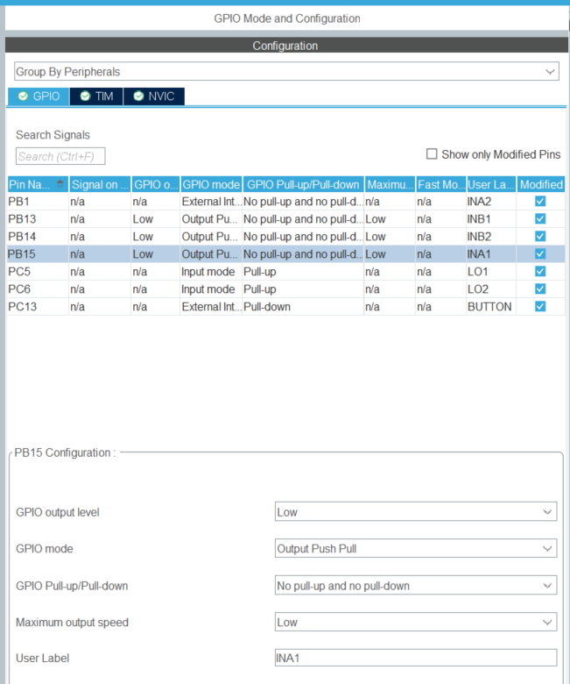
Lab3b: Read and control motor position
Example: INA1 setting
Notes:
F:\AEE\AEE2\BSW\BSW Goals\ST firmware\StudentLab2024\Lab1b\Lab1b_LED_Button

Slide 21
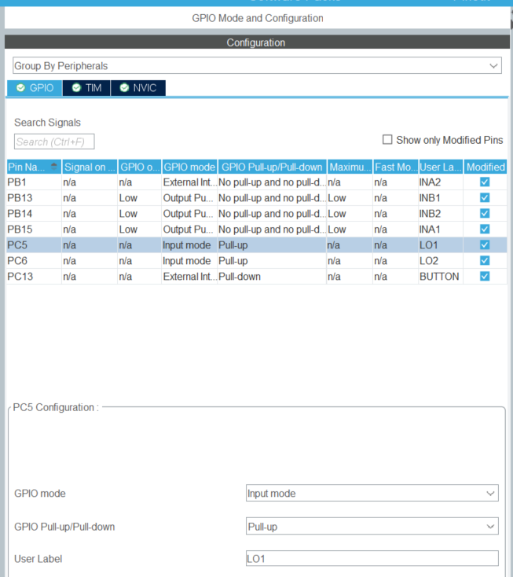
Lab3b: Read and control motor position
Example: LO1 setting
Notes:
F:\AEE\AEE2\BSW\BSW Goals\ST firmware\StudentLab2024\Lab1b\Lab1b_LED_Button

Slide 22
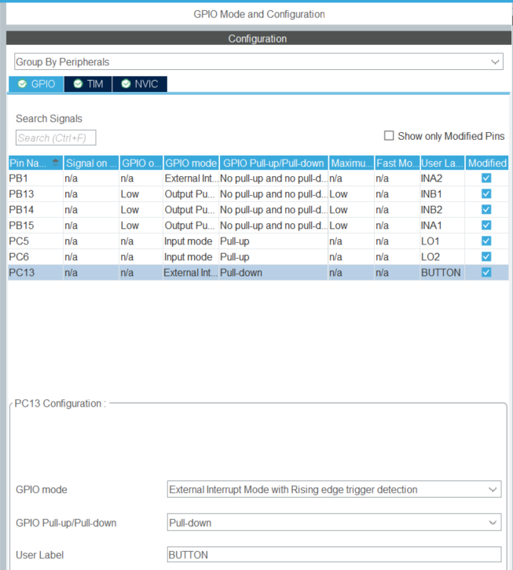
Lab3b: Read and control motor position
Example: BUTTON setting
Notes:
F:\AEE\AEE2\BSW\BSW Goals\ST firmware\StudentLab2024\Lab1b\Lab1b_LED_Button

Slide 23
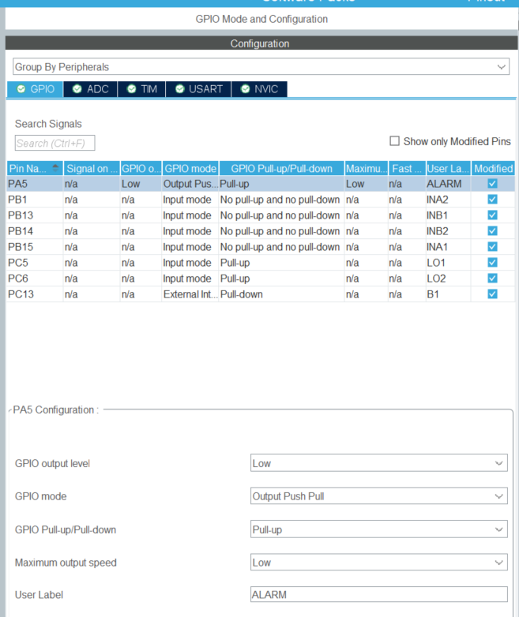
Lab3b: Read and control motor position
Example: LED setting
Notes:
F:\AEE\AEE2\BSW\BSW Goals\ST firmware\StudentLab2024\Lab1b\Lab1b_LED_Button

Slide 24
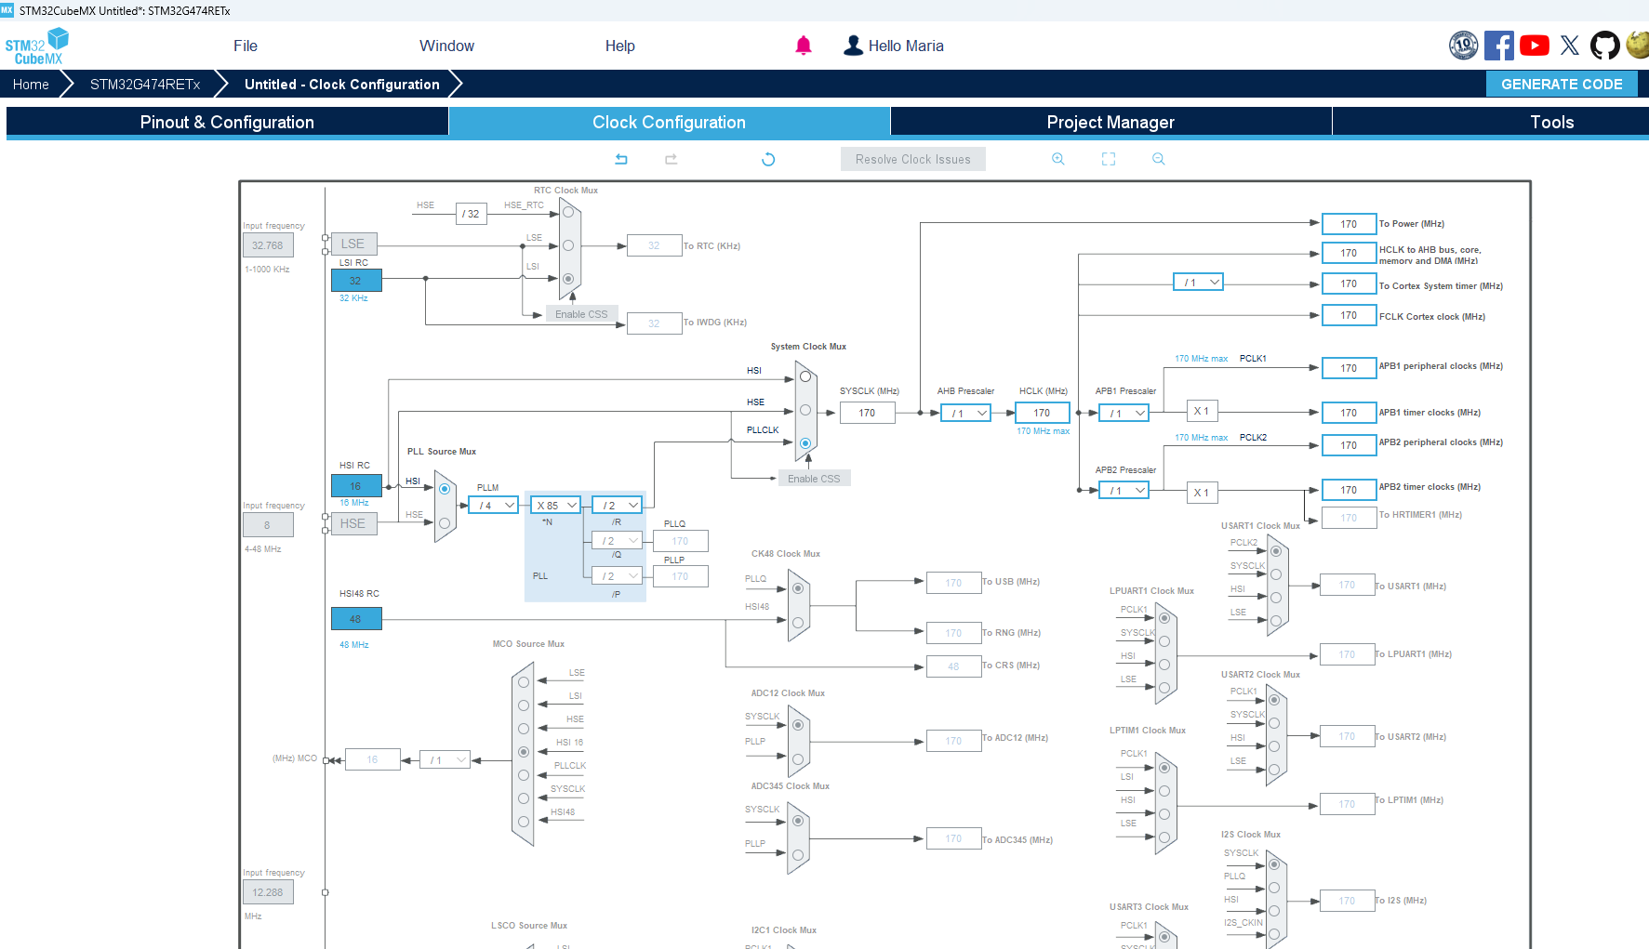
Lab3b: Read and control motor position
Fill with 170 and it will find the solution automatically
Notes:
F:\AEE\AEE2\BSW\BSW Goals\ST firmware\StudentLab2024\Lab1b\Lab1b_LED_Button

Slide 25
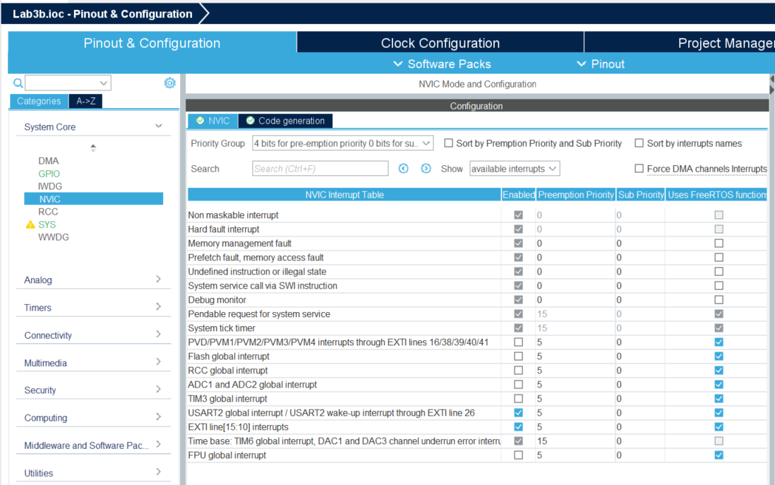
Lab3b: Read and control motor position
Check or set NVIC Mode and Configuration (1):
Notes:
F:\AEE\AEE2\BSW\BSW Goals\ST firmware\StudentLab2024\Lab1b\Lab1b_LED_Button

Slide 26
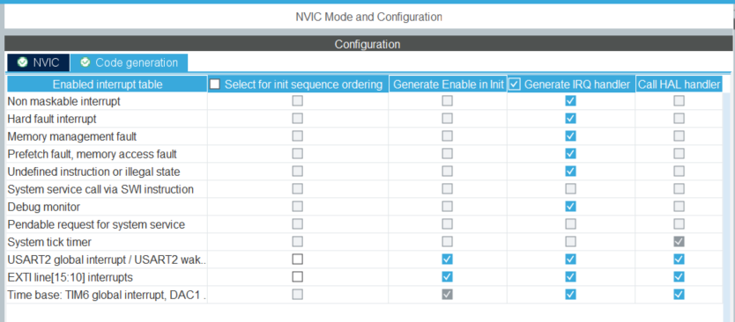
Lab3b: Read and control motor position
Check or set NVIC Mode and Configuration (2):
Notes:
F:\AEE\AEE2\BSW\BSW Goals\ST firmware\StudentLab2024\Lab1b\Lab1b_LED_Button

Slide 27
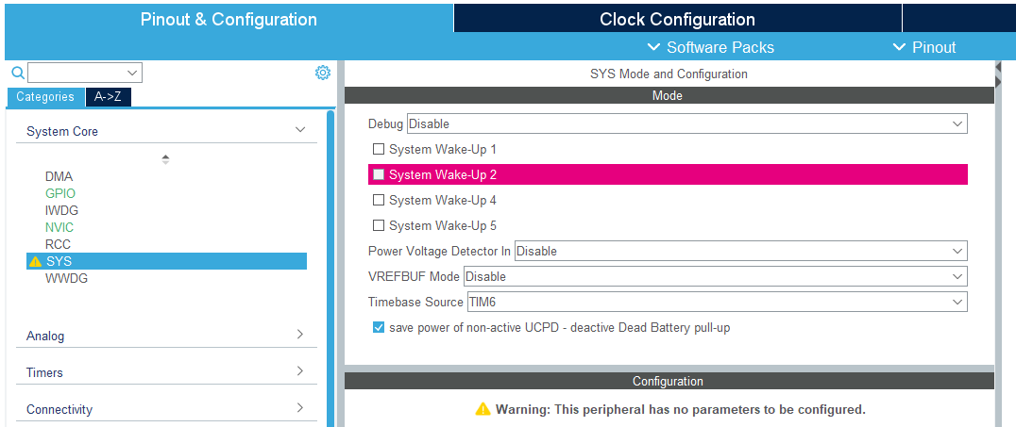
Lab3b: Read and control motor position
Set SYS Mode and Configuration as below:
Select Timebase Source other than SysTick
for FreeRTOS based code
Notes:
F:\AEE\AEE2\BSW\BSW Goals\ST firmware\StudentLab2024\Lab1b\Lab1b_LED_Button

Slide 28
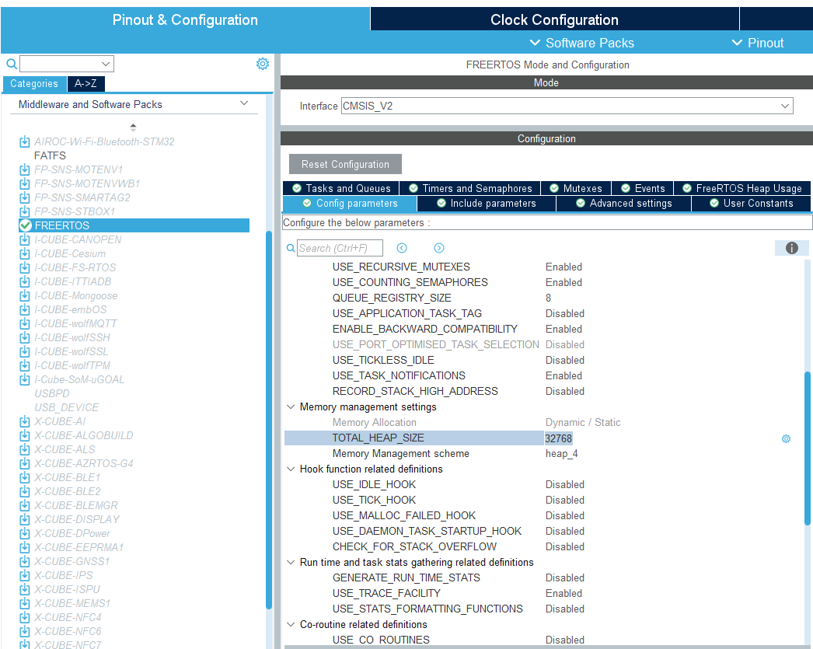
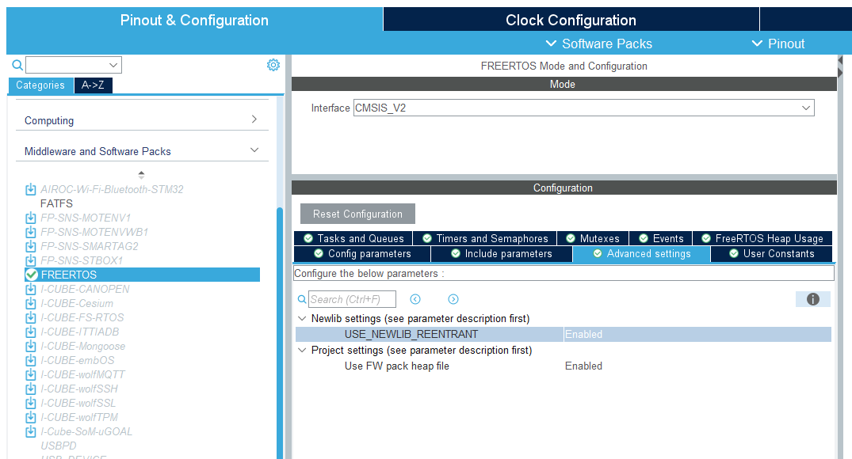
Lab3b: Read and control motor position
Set FREERTOS Mode and Configuration as below (1):
Notes:
F:\AEE\AEE2\BSW\BSW Goals\ST firmware\StudentLab2024\Lab1b\Lab1b_LED_Button

Slide 29
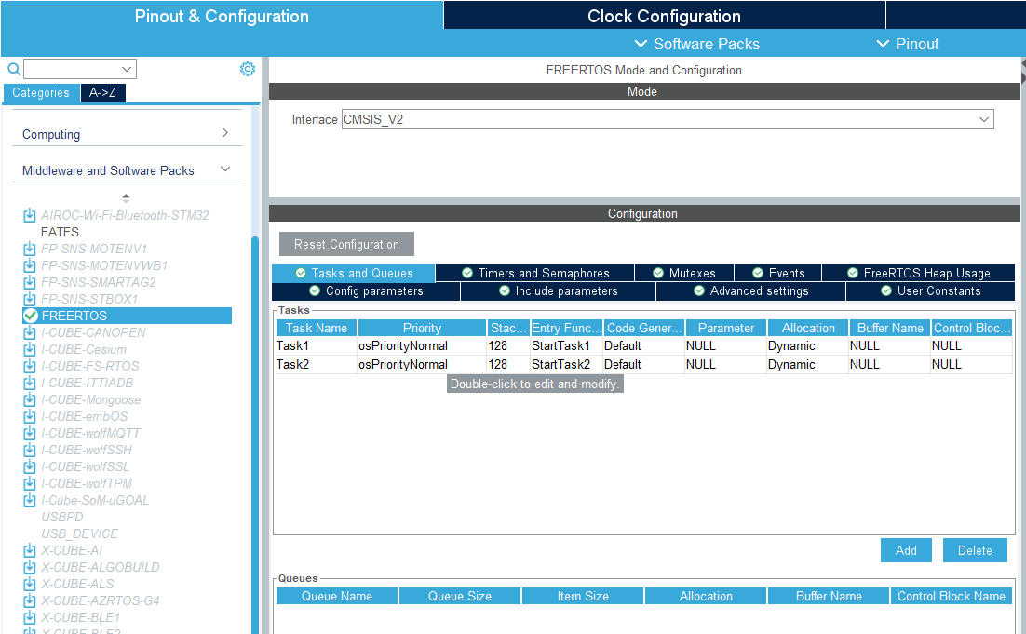
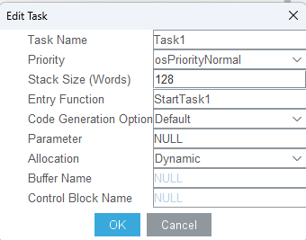
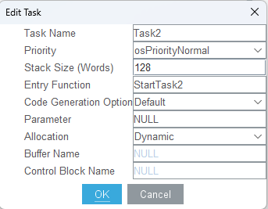
Lab3b: Read and control motor position
Set FREERTOS Mode and Configuration as below (2):
Notes:
F:\AEE\AEE2\BSW\BSW Goals\ST firmware\StudentLab2024\Lab1b\Lab1b_LED_Button

Slide 30
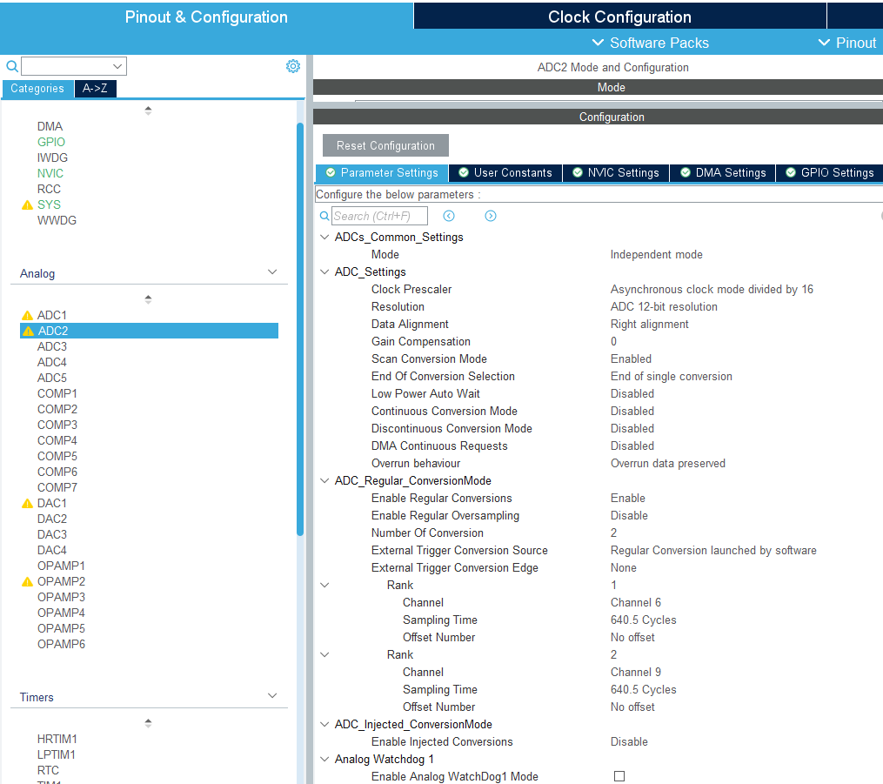
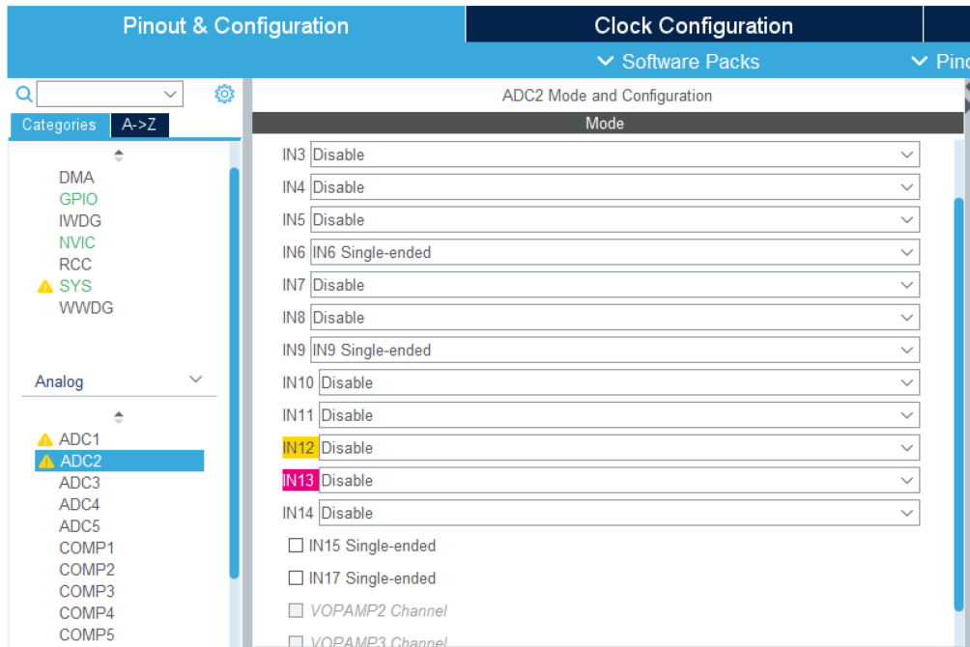
Lab3b: Read and control motor position
Set ADC2 Mode and Configuration (1):
Notes:
F:\AEE\AEE2\BSW\BSW Goals\ST firmware\StudentLab2024\Lab1b\Lab1b_LED_Button

Slide 31
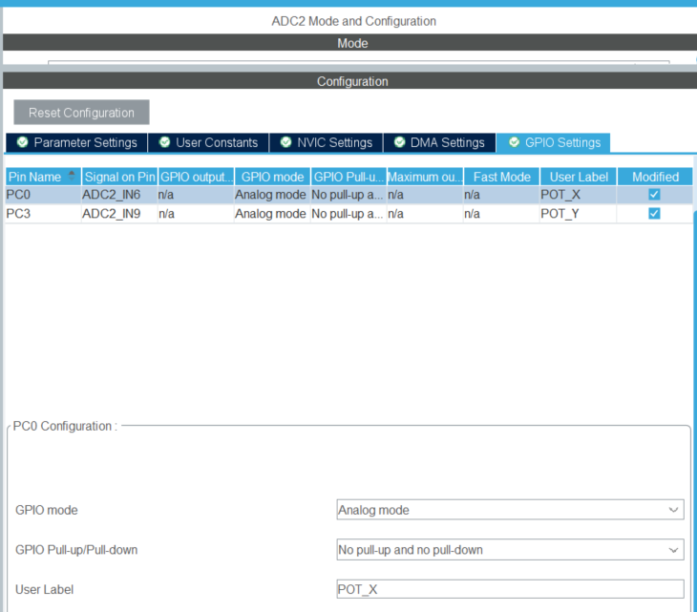
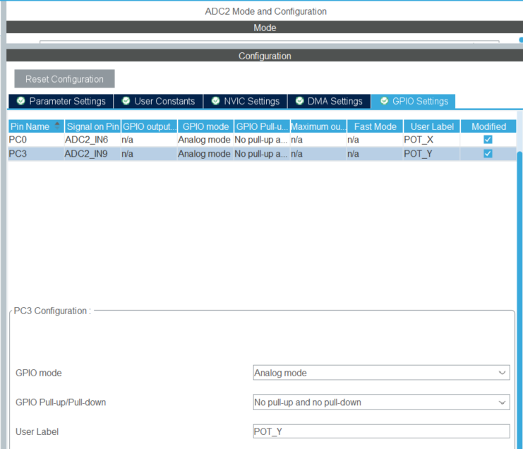
Lab3b: Read and control motor position
Set ADC2 Mode and Configuration (2):
Notes:
F:\AEE\AEE2\BSW\BSW Goals\ST firmware\StudentLab2024\Lab1b\Lab1b_LED_Button

Slide 32
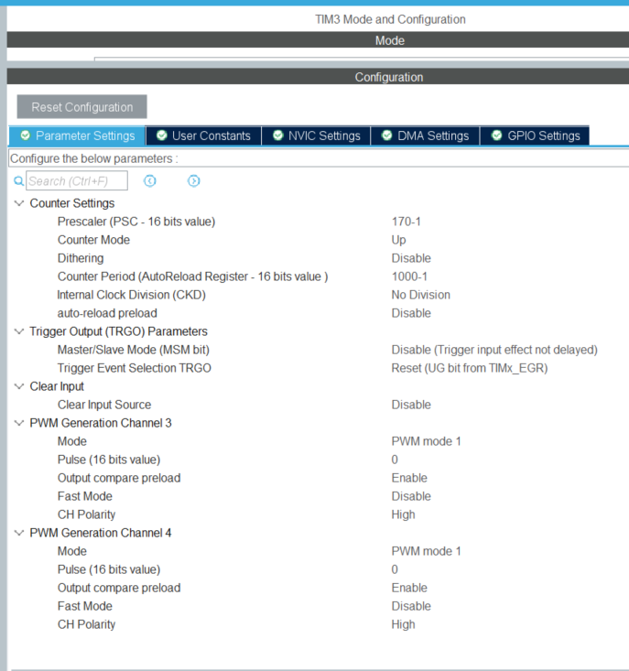
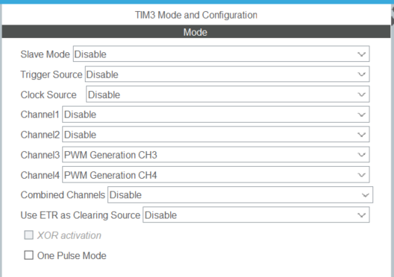
Lab3b: Read and control motor position
Set TIM3 Mode and Configuration:
Notes:
F:\AEE\AEE2\BSW\BSW Goals\ST firmware\StudentLab2024\Lab1b\Lab1b_LED_Button

Slide 33
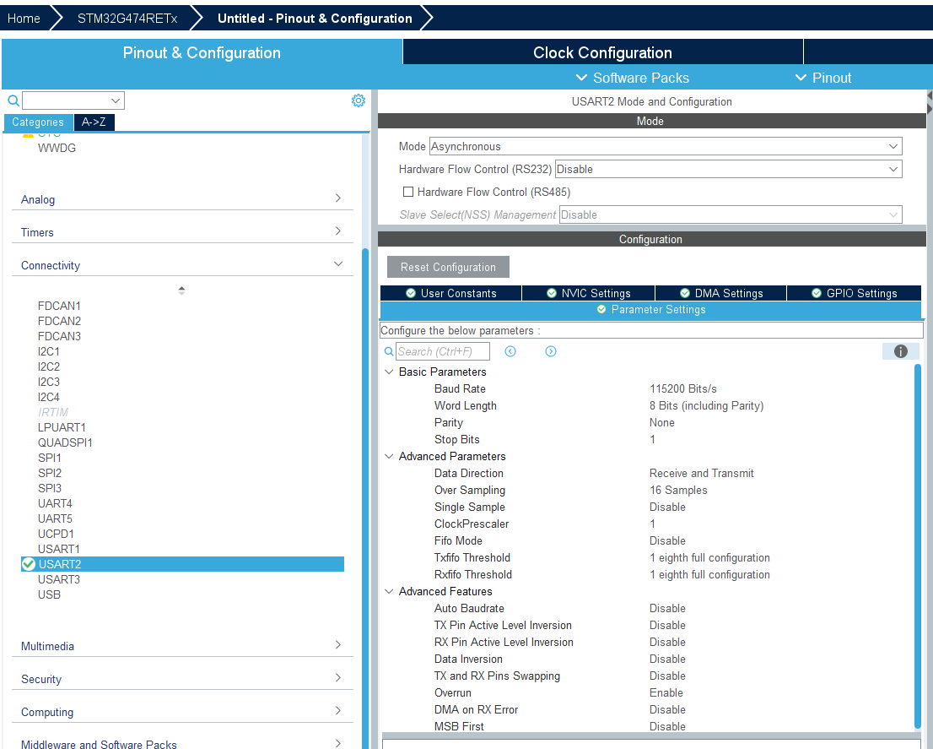
Lab3b: Read and control motor position
Set USART2 Mode and Configuration (1):
Notes:
F:\AEE\AEE2\BSW\BSW Goals\ST firmware\StudentLab2024\Lab1b\Lab1b_LED_Button

Slide 34
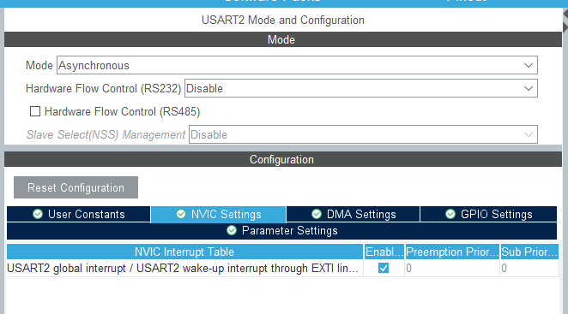
Lab3b: Read and control motor position
Set USART2 Mode and Configuration (1):
Notes:
F:\AEE\AEE2\BSW\BSW Goals\ST firmware\StudentLab2024\Lab1b\Lab1b_LED_Button

Slide 35
Lab3b: Read and control motor position
Reading potentiometer (analog input / ADC)
Notes:
F:\AEE\AEE2\BSW\BSW Goals\ST firmware\StudentLab2024\Lab1b\Lab1b_LED_Button

Slide 36
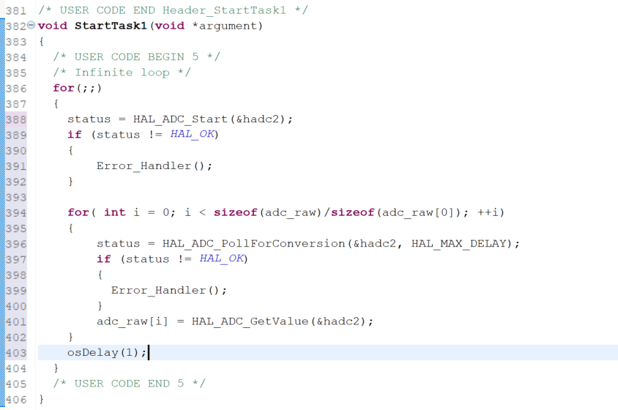
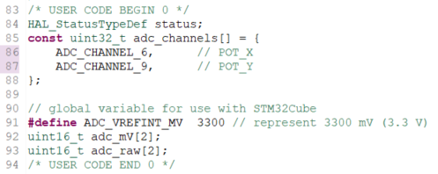
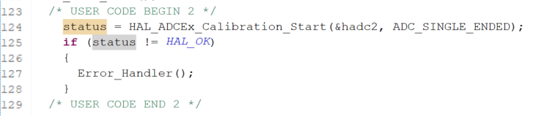
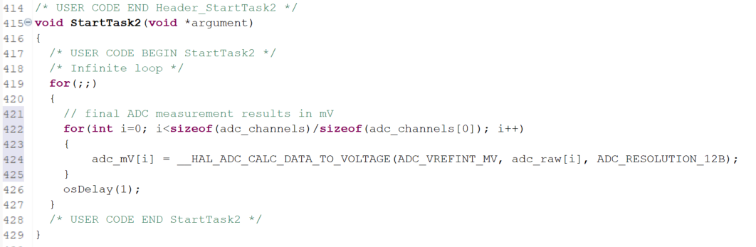
Lab3b: Read and control motor position
In main.c
Notes:
F:\AEE\AEE2\BSW\BSW Goals\ST firmware\StudentLab2024\Lab1b\Lab1b_LED_Button

Slide 37
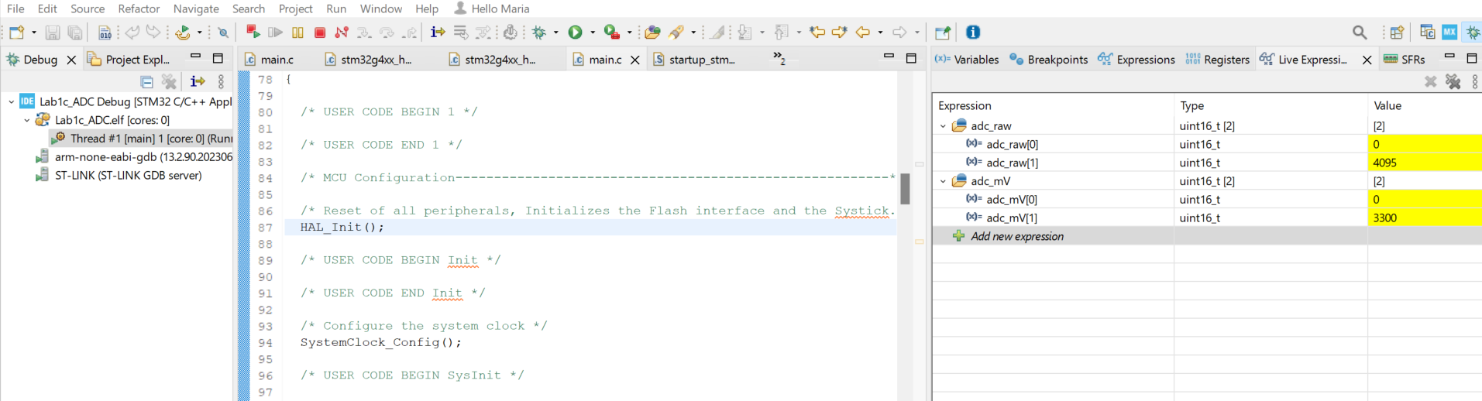
Lab3b: Read and control motor position
Observe the values of adc_raw and adc_mV in Live Expression
Notes:
F:\AEE\AEE2\BSW\BSW Goals\ST firmware\StudentLab2024\Lab1b\Lab1b_LED_Button

Slide 38
Lab3b: Read and control motor position
Display the value from potentiometer
as value of PWM duty cycle (0-100%)
to UART
Notes:
F:\AEE\AEE2\BSW\BSW Goals\ST firmware\StudentLab2024\Lab1b\Lab1b_LED_Button

Slide 39
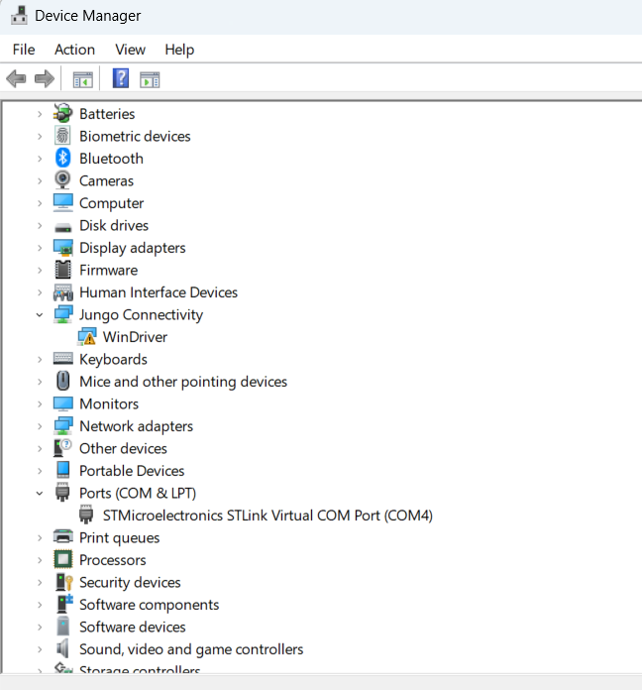
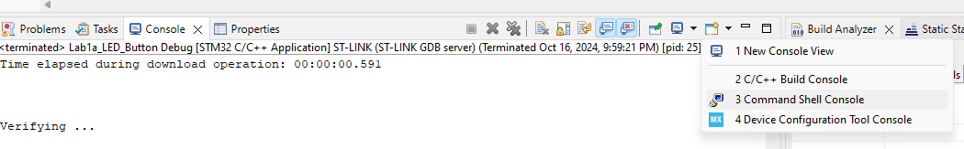
Lab3b: Read and control motor position
To use serial print to monitor in STM32CubeIDE
Go to the Device Manager and check the STLink Virtual COM Port
From Console tab of STM32CubeIDE
Notes:
F:\AEE\AEE2\BSW\BSW Goals\ST firmware\StudentLab2024\Lab1d\Lab1d_UART

Slide 40
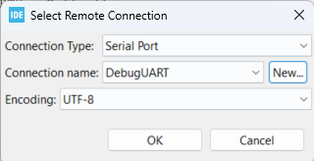
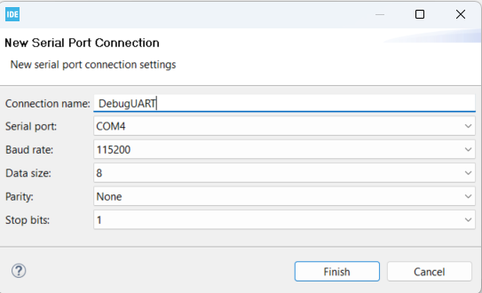
Lab3b: Read and control motor position
Put connection name and COM settings
The COM setting must be the same with UART settings
Notes:
F:\AEE\AEE2\BSW\BSW Goals\ST firmware\StudentLab2024\Lab1d\Lab1d_UART

Slide 41
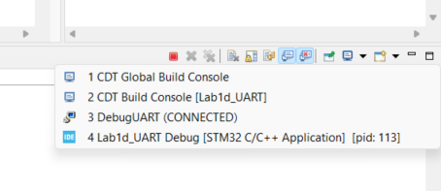
Lab3b: Read and control motor position
If the serial monitor connection is already created, for the next debugging process, we can directly choose the connection by selecting from the button below.
Notes:
F:\AEE\AEE2\BSW\BSW Goals\ST firmware\StudentLab2024\Lab1d\Lab1d_UART

Slide 42

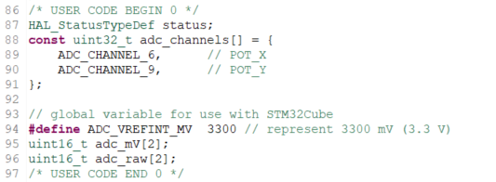
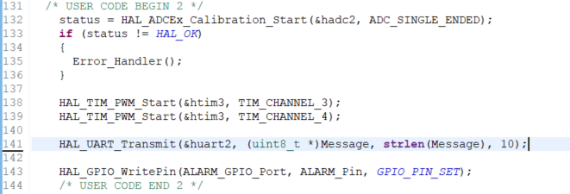
Lab3b: Read and control motor position
In main.c (1)
The serial monitor will display the initial message
Notes:
F:\AEE\AEE2\BSW\BSW Goals\ST firmware\StudentLab2024\Lab1d\Lab1d_UART

Slide 43
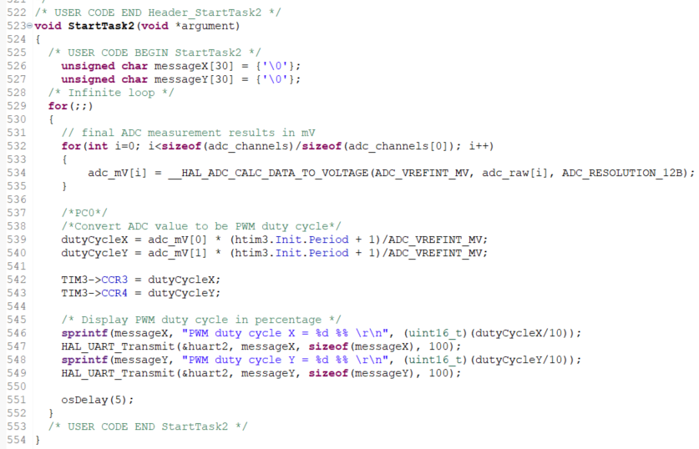
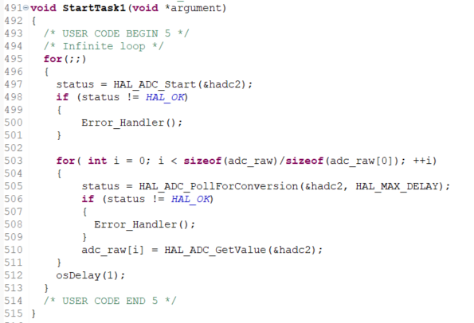
Lab3b: Read and control motor position
In main.c (2)
Notes:
F:\AEE\AEE2\BSW\BSW Goals\ST firmware\StudentLab2024\Lab1d\Lab1d_UART

Slide 44
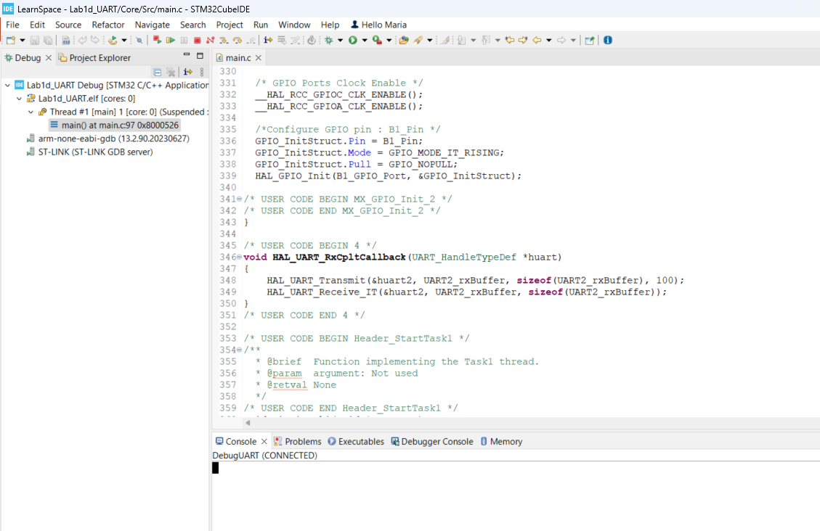
Lab3b: Read and control motor position
- Build and debug code
Notes:
F:\AEE\AEE2\BSW\BSW Goals\ST firmware\StudentLab2024\Lab1d\Lab1d_UART

Slide 45
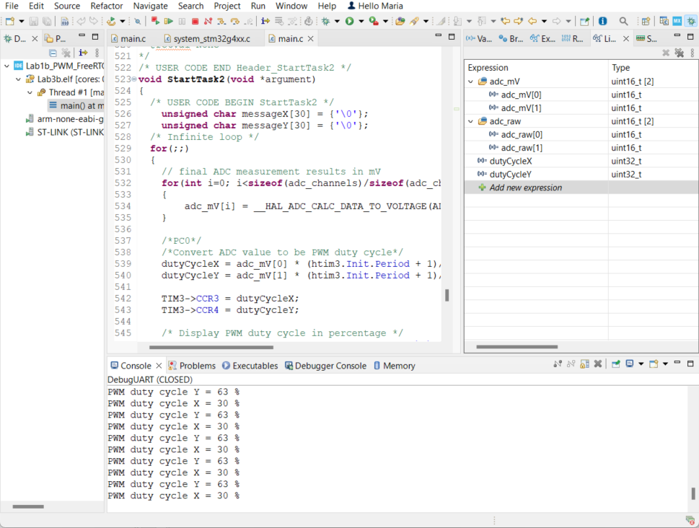
Lab3b: Read and control motor position
Click Connect button if the Console is CLOSED
Notes:
F:\AEE\AEE2\BSW\BSW Goals\ST firmware\StudentLab2024\Lab1d\Lab1d_UART

Slide 46
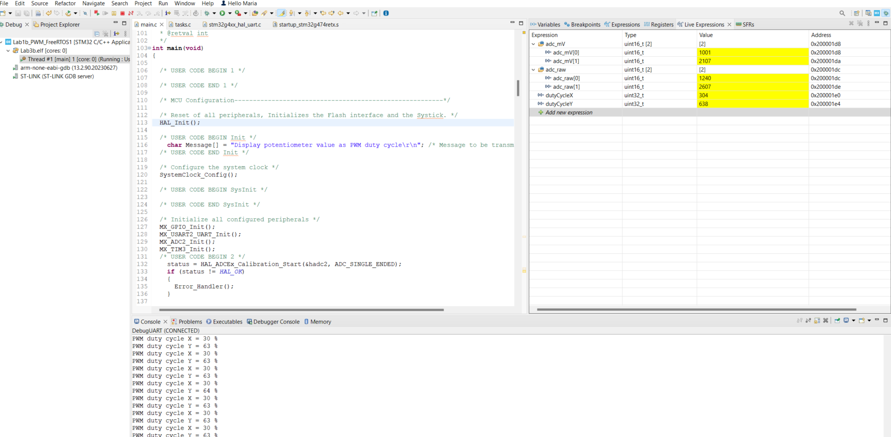
Lab3b: Read and control motor position
Resume and observe the values of adc_raw, adc_mV, dutyCycleX, dutyCycleY in Live Expression
Measure the voltage in PC8 and PC9.
They should be the same with adc_mV[0] and adc_mV[1]
Notes:
F:\AEE\AEE2\BSW\BSW Goals\ST firmware\StudentLab2024\Lab1b\Lab1b_LED_Button

Slide 47
Lab3b: Read and control motor position
Use PWM duty cycle as Motor control
Please remember that:
PWM from NUCLEO gives maximum voltage 3.3 VDC
Notes:
F:\AEE\AEE2\BSW\BSW Goals\ST firmware\StudentLab2024\Lab1b\Lab1b_LED_Button

Slide 48
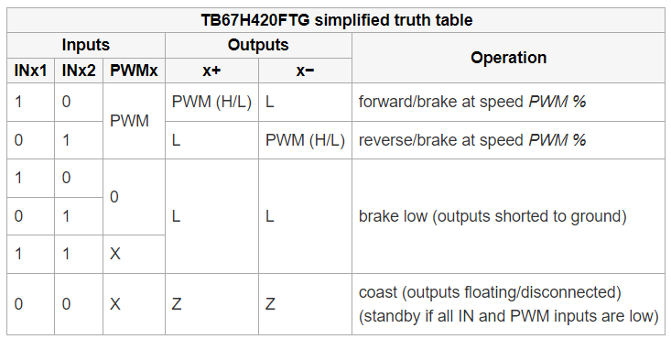
Lab3b: Read and control motor position
Truth table of INx1, INx2, and PWMx
Notes:
F:\AEE\AEE2\BSW\BSW Goals\ST firmware\StudentLab2024\Lab1b\Lab1b_PWM_FreeRTOS1

Slide 49
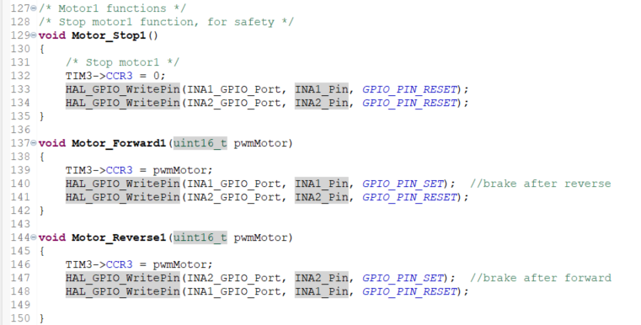


Lab3b: Read and control motor position
Implementation: in main.c
Notes:
F:\AEE\AEE2\BSW\BSW Goals\ST firmware\StudentLab2024\Lab1b\Lab1b_PWM_FreeRTOS1

Slide 50


Lab3b: Read and control motor position
To be noticed for LO1 and LO2
Truth table of LO1 and LO2
Compare these rows with the code of the next page
Notes:
F:\AEE\AEE2\BSW\BSW Goals\ST firmware\StudentLab2024\Lab1b\Lab1b_PWM_FreeRTOS1

Slide 51



Lab3b: Read and control motor position
Implementation of LO1 and LO2:
in main.c
Notes:
F:\AEE\AEE2\BSW\BSW Goals\ST firmware\StudentLab2024\Lab1b\Lab1b_PWM_FreeRTOS1

Slide 52


Lab3b: Read and control motor position
Button implementation, in main.c
Notes:
F:\AEE\AEE2\BSW\BSW Goals\ST firmware\StudentLab2024\Lab1b\Lab1b_PWM_FreeRTOS1

Slide 53
Lab3b: Read and control motor position
Lab3b: Read and control motor position
PWM duty cycle for PWMA
The voltages after voltage divider of POT_X is:
Min = 1.154 VDC (for 5K resistance)
Max = 3 VDC (for 1K resistance)
PWM duty cycle for PWMB
The voltages after voltage divider of POT_Y is:
Min = 2.423 VDC (for 5K resistance)
Max = 3 .052 VDC (for 3K resistance)
The PWM input of Motor driver needs >= 2.0 VDC as HIGH input.
The voltage after voltage divider that is less than 2.0 VDC will be set as 2.0 VDC as PWM output from NUCLEO to PWM input of Motor driver to give enough voltage as HIGH input.
Note: In the code, the threshold 2.05 VDC will be used (not 2.0 VDC) to ensure that it gives enough voltage as HIGH
Notes:
F:\AEE\AEE2\BSW\BSW Goals\ST firmware\StudentLab2024\Lab1b\Lab1b_LED_Button

Slide 54


Lab3b: Read and control motor position
One button implementation, in main.c, StartTask1 and StartTask2 functions
Notes:
F:\AEE\AEE2\BSW\BSW Goals\ST firmware\StudentLab2024\Lab1b\Lab1b_PWM_FreeRTOS1

Slide 55



Lab3b: Read and control motor position
One button implementation, in main.c, StartTask1 function
Notes:
F:\AEE\AEE2\BSW\BSW Goals\ST firmware\StudentLab2024\Lab1b\Lab1b_PWM_FreeRTOS1

Slide 56

Lab3b: Read and control motor position
Debugging
We can observe the variables in Live Expressions and PWM value in Console
POT_X value in mV
POT_Y value in mV
dutyCycleX
dutyCycleY
Notes:
F:\AEE\AEE2\BSW\BSW Goals\ST firmware\StudentLab2024\Lab1b\Lab1b_PWM_FreeRTOS1

Slide 57
Lab2b: Forward and reverse of motor using buttons
Observe the behavior of mirror’s motors!
First pressing → motor 1 runs in forward direction for 1s with some speed
Second pressing → motor 1 runs in reverse direction for 1s with some speed
Third pressing → motor 2 runs in forward direction for 1s with some speed
Fourth pressing → motor 2 runs in reverse direction for 1s with some speed
Another pressing will come back to first pressing, and so on
No button is pressed → no motor running

Slide 58
Thank you and good luck!

